Slide 1


<Insert Picture Here>
Using the Virtual Machine

Slide 2
Requirements
Hardware must support virtualization !
Not all Windows PC do so!
If no support: “vt-x/amd-v hardware acceleration is not available”
Or “this kernel requires an x86-64 CPU, but only detects an i686 CPU, unable to boot“
Virtualization support must be enabled in your BIOS
Works best on a 64bit OS
May not work with a 32bit OS!
Needs adequate resources on your host!
Minimum 4GB RAM
20 GB available disk space

Slide 3
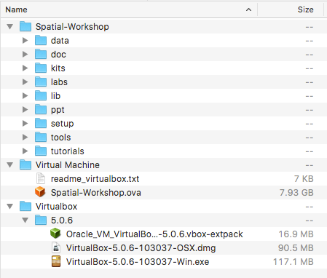
Contents of Memory Stick
Workshop Material
Virtual Machine
Virtualbox

Slide 4
Using the Workshop Virtual Machine
Copy all material from memory stick
Install Oracle Virtual Box
Import the virtual machine
Setup shared Folders
Start the virtual machine
Virtual machine configuration
Accounts and passwords
Network access

Slide 5
Install Oracle Virtual Box
Available on Windows, Linux, MacOSX, …
Supports virtual machines in any x86 or x64 OS
Windows, Linux, Solaris
Download from http://www.virtualbox.org
Manual: https://www.virtualbox.org/manual/UserManual.html
Also install the Extension Pack
host = your machine (laptop or desktop)
guest = a virtual machine

Slide 6
Rebuild Virtual Machine Appliance File
Only if you downloaded the material from the web
The VM appliance file (OVA) is split into many small files
Need to reassemble it first …
Check that the checksum is correct. Should be the same as the checksum in file checksum.md5
cat Spatial-Workshop.ova.part-* > Spatial-Workshop.ova
md5 Spatial-Workshop.ova

Slide 7
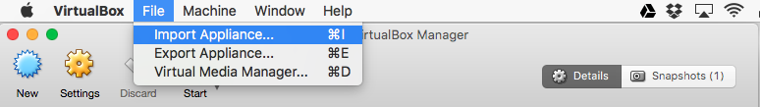
Import the Virtual Machine
Start VirtualBox Manager
“File” menu, then “Import Appliance”
Select file spatial-workshop.ova
Takes from 5 to 10 minutes
Needs some 20GB on disk

Slide 8
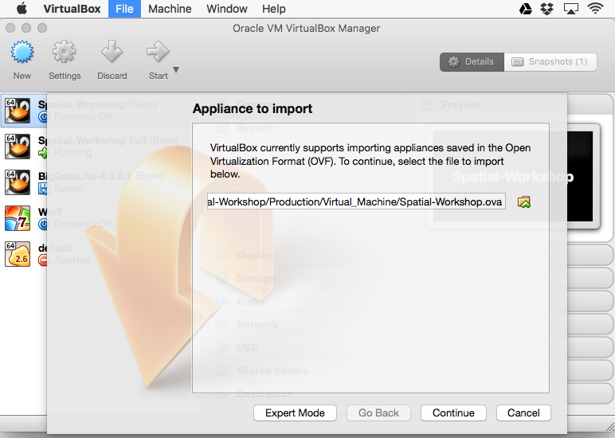

Slide 9
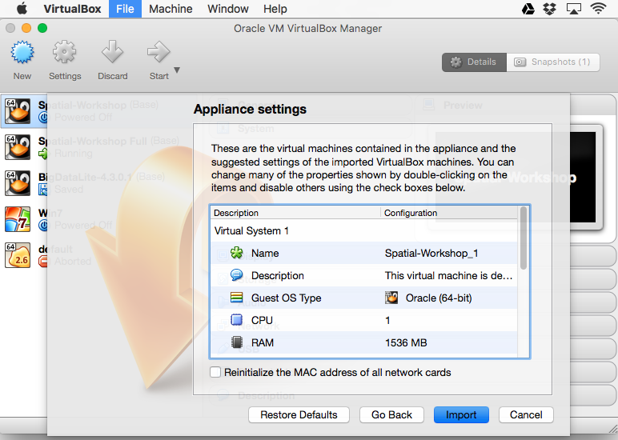

Slide 10
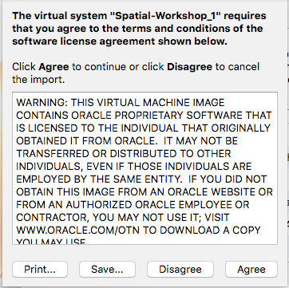

Slide 11
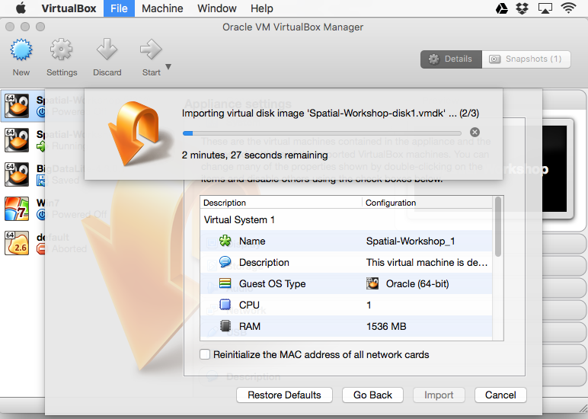

Slide 12
Using Snapshots
You can take a “Snapshot” at any point during the life of your VM.
This saves the complete state of your machine
You can then go back to a previous snapshot (= state).
Suggestion: take a snapshot immediately after importing the VM
You can then go back to the original state without re-importing the entire machine from the OVA.

Slide 13
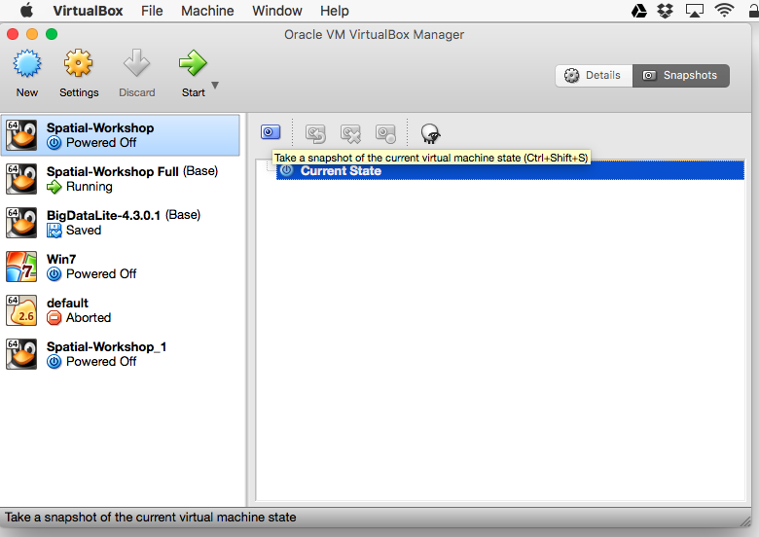

Slide 14
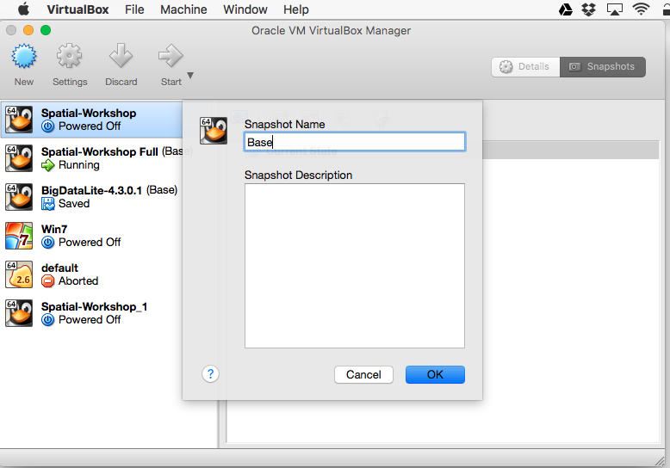

Slide 15
Setup Shared Folders
Required to share workshop files with the VM
Do this before booting your VM
Click on “Settings”, then “Shared Folders”
Click “+” to create a new share
Select the host folder to share with your guest VM
Choose folder “Workshop_Files” (contains all files and scripts)
Tick “Auto mount” so the share mounts automatically on next boot
Files are available inside your VM as
/media/sf_Workshop_Files

Slide 16
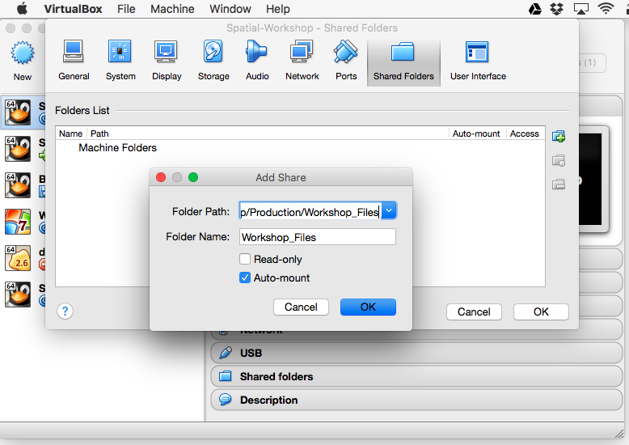

Slide 17
Mount Shared Folders on a running VM
ONLY needed when adding shared folders on an already running VM
This is NOT needed if you define the shared folders BEFORE booting the VM!
sudo mkdir /media/sf_Workshop_Files
sudo mount -t vboxsf -o gid=vboxsf,dmode=770,fmode=770 \
Workshop_Files /media/sf_Workshop_Files

Slide 18
Starting the Virtual Machine
Start VirtualBox Manager
Select virtual machine to start and click green start arrow.
Or just double-click the machine
The machine now boots and waits for a user and password
Use user “spatial” and password “spatial”
Files for the workshop will be in
/media/sf_Workshop_Files

Slide 19
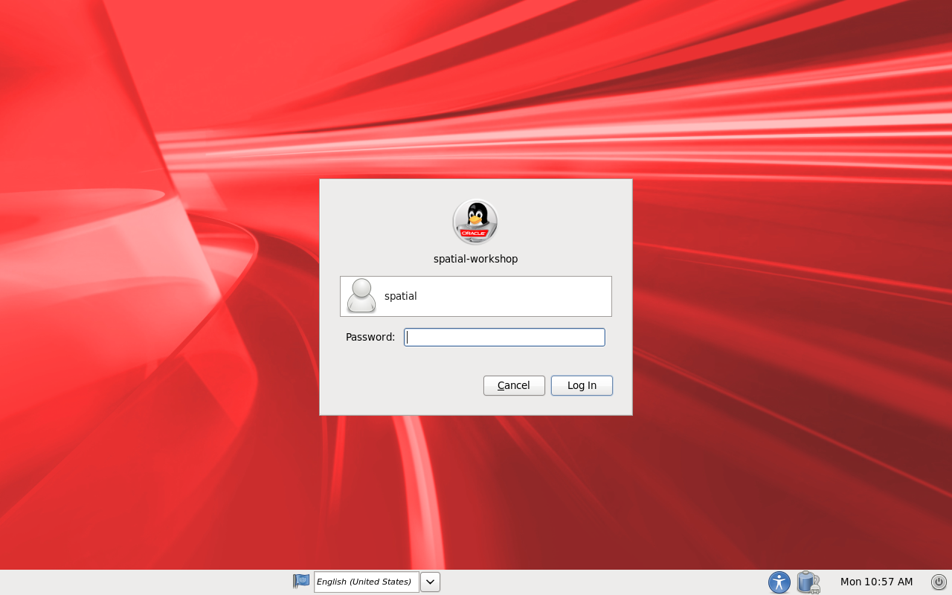

Slide 20
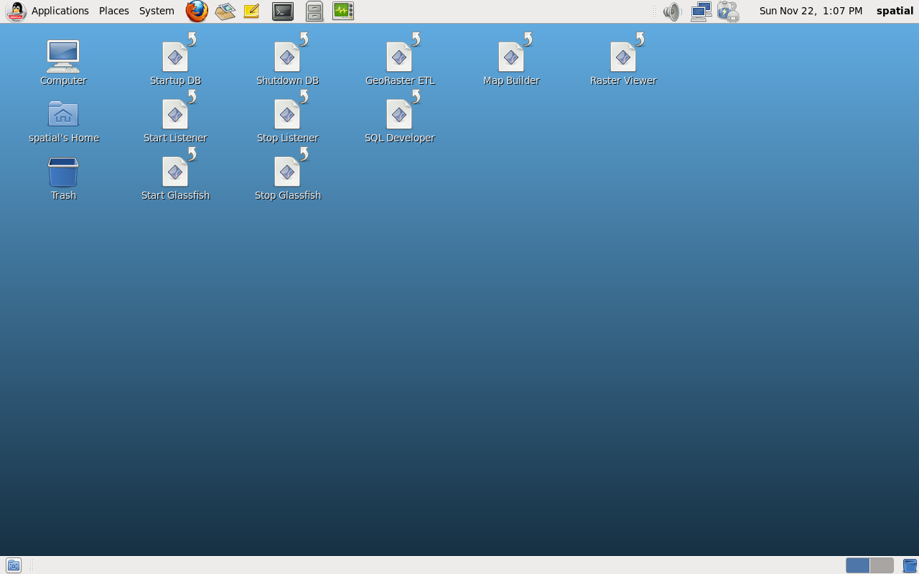

Slide 21
Problems Starting the VM ?
Does your hardware support virtualization ?
On some Windows PC it may be necessary to enable virtualization in the BIOS.
Running a 64-bit VM on 32-bit OS/hardware is sometimes possible

Slide 22
Configuring your keyboard
The Virtual Machine is setup to use a US Qwerty keyboard
If your keyboard is different, change the setting inside the VM
Go to System/Preferences/Keyboard
Tab “Layouts”
Click “Add” and choose the appropriate layout
Tick “Default” against your preferred layout
Applies to new processes only

Slide 23
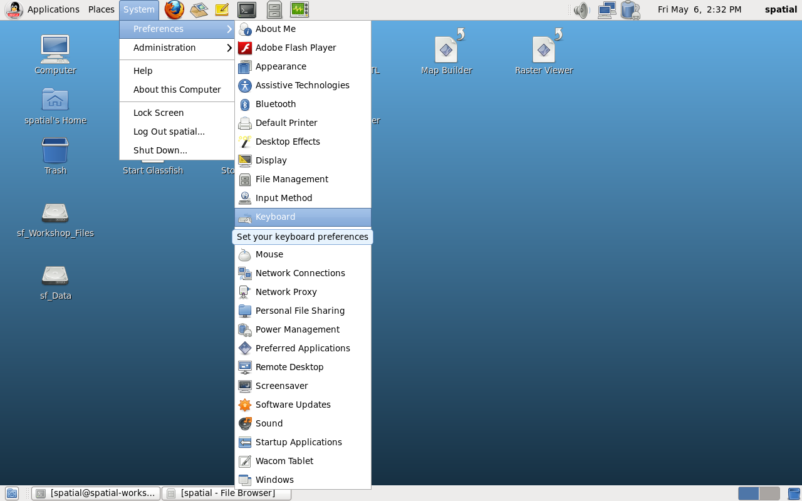
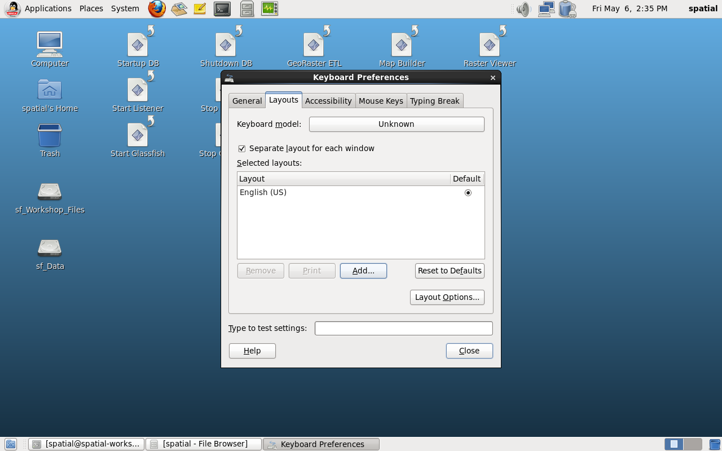

Slide 24
Starting the Database
Use scripts on the desktop of user spatial:
startup-db
shutdown-db
start-listener
stop-listener
Double click, then “Run in terminal”
To start the database automatically on boot
Modify /etc/oratab
﻿orcl122:/home/oracle/app/oracle/product/12.2.0/dbhome_1:Y
﻿

Slide 25
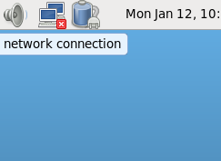
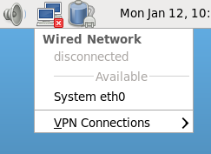
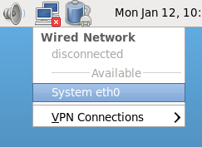
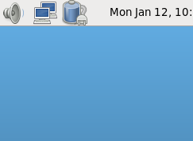
Connecting to the Network
The virtual network adapter eth0 is not active by default
Enable it after each boot/restart
Or use the command line:
$ sudo ifup eth0

Slide 26
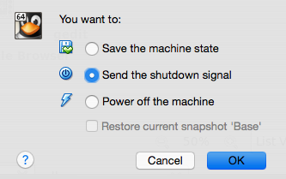
Stopping the Virtual Machine
Shutdown using the VirtualBox environment
Machine / Close menu
Option1: Save the machine state
Saves the machine so it can be restarted exactly as it was
Option 2: Send the shutdown signal
Same as shutting down from the OS
Option 3: Power off the machine
Pull the (virtual) plug – no shutdown steps taken.
Can also shutdown from the guest OS

Slide 27
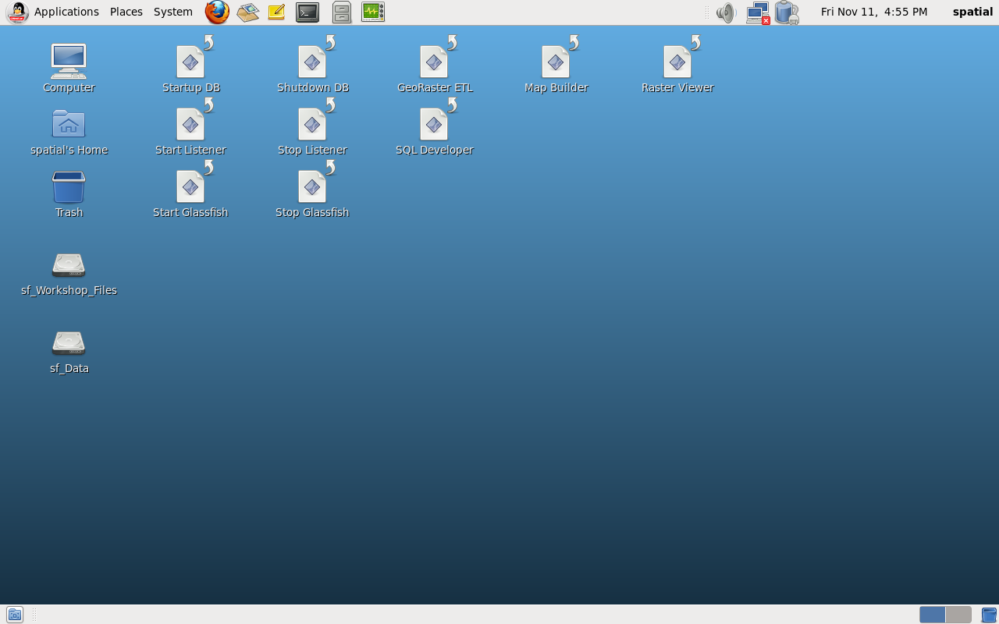
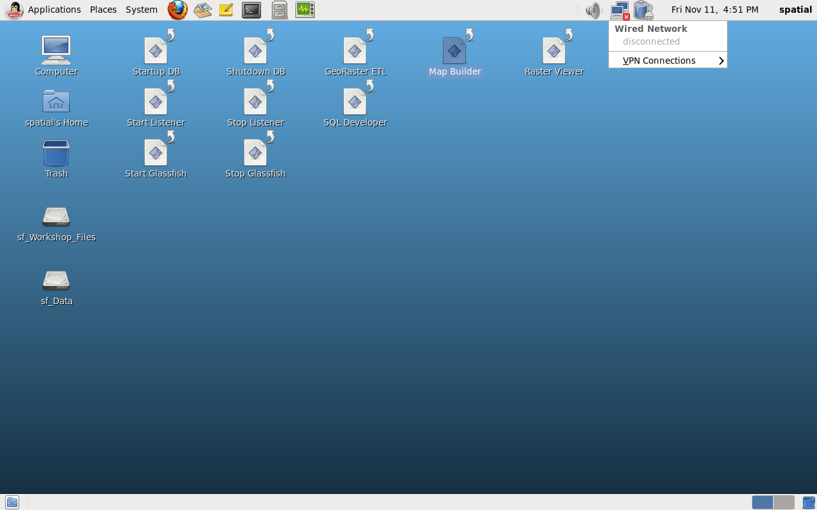
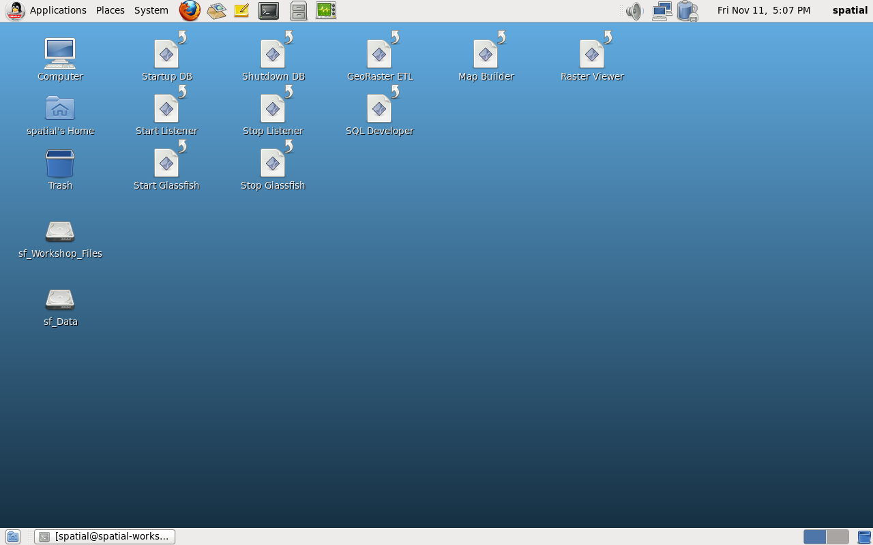
No Network Connection on Restart ?
The network may not reconnect when you restart a saved virtual machine.
Adapter eth0 is no longer present!
This happens when your host moved to a different network (office to home, …)
The solution: restart the network manager daemon:
$ sudo service NetworkManager restart
Stopping NetworkManager daemon: [OK]
Setting network parameters... [OK]
Starting NetworkManager daemon: [OK]

Slide 28
Accounts and Passwords
Machine usernames and passwords
root = oracle
oracle = oracle
spatial = spatial
Do not login as root or oracle. If needed, just “su” or “sudo”
Database usernames and passwords
sys/oracle
system/oracle
scott/tiger
Glassfish username and password
admin/welcome1
Database configuration
ORACLE_HOME = /home/oracle/app/oracle/product/12.2.0/dbhome_1
Service name = orcl122

Slide 29
Hardware Configuration of the VM
Use VirtualBox manager to see the configuration.
Select virtual machine and click Settings.
Memory: 2 GB RAM
CPU: single cpu, single core, 64bit
Disk: one virtual drive (32GB)
Drives are stored as “sparse” files. Only used blocks are stored
Actual on disk is approximately 20 GB
Network: one NAT adapter

Slide 30
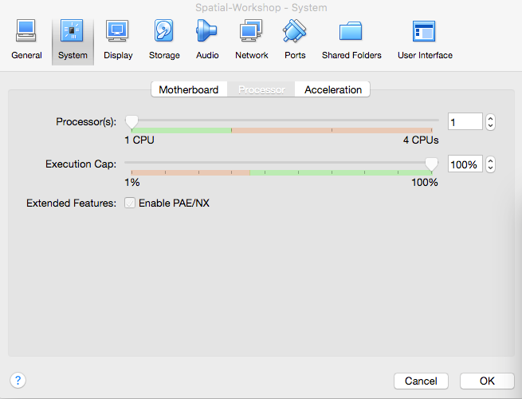
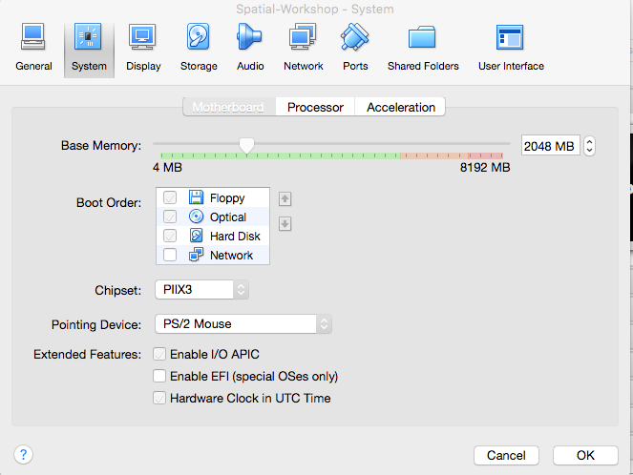

Slide 31
Software Configuration of the VM
Operating system:
Oracle Enterprise Linux 6 (OEL6 6.3)
Database:
Oracle RDBMS 12.2.0.1
Application server:
GlassFish Server Open Source Edition 4.1
SQLDeveloper 4.1.0
Mapbuilder, Raster Viewer, Georaster ETL, Mapviewer
VirtualBox extensions
Full mouse, keyboard and clipboard integration

Slide 32
Network Access
One NAT adapter configured
Allows the VM to “dial-out” to the external world using your host machine internet connection (wired or wireless)
Does not allow external access to your VM
If needed, consider the following options:
Add a HOST ONLY adapter
Allows access from your host only
Or replace the NAT adapter with BRIDGED adapter(s)
Directly connects your VM to the LAN
May need two bridged adapters: one for WIFI, one for Ethernet
See the Virtual Box manual – “Virtual Networking”
https://www.virtualbox.org/manual/ch06.html

Slide 33
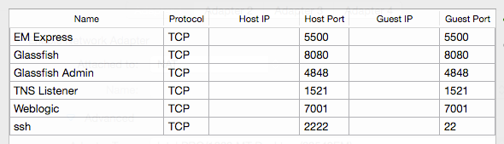
Port Forwarding
The NAT adapter is configured with port forwarding
Allows you to connect to applications running on the VM directly from your host …

Slide 34
Port Forwarding
Telnet/ssh (notice the explicit port number 2222)
sqlplus (use the same connect string for other tools)
Enterprise manager
Glassfish console
Mapviewer
$ ssh -p2222 spatial@localhost
$ sqlplus scott/tiger@localhost:1521/orcl122
http://localhost:5500/em
https://localhost:4848
http://localhost:8080/mapviewer

Slide 35
Known Issues
Sometimes cut and paste from the guest (the VM) to the host stops working.
When that happens, just restart the process that handles the clipboard:
$ pkill 'VBoxClient --clipboard' -f
$ VBoxClient --clipboard

Slide 36
Build your own VM in 10 easy steps!
Download and install Virtual Box
Download Oracle Enterprise Linux installation kit (ISO file)
Download Oracle Database 12c Release 1 installation kit
Create new VM
Connect OEL kit (ISO file) to virtual CD drive
Boot VM from CD
Install OEL
Setup shared folders to access Oracle 12cR2 kit
Install Oracle 12cR2 and create starter database
Download and install other tools (GDAL etc)
Many guides available on line. For example:
http://technology.amis.nl/2013/06/29/how-to-create-a-virtual-box-vm-with-oracle-enterprise-linux-inside-a-dummy-guide/

